Slide 1
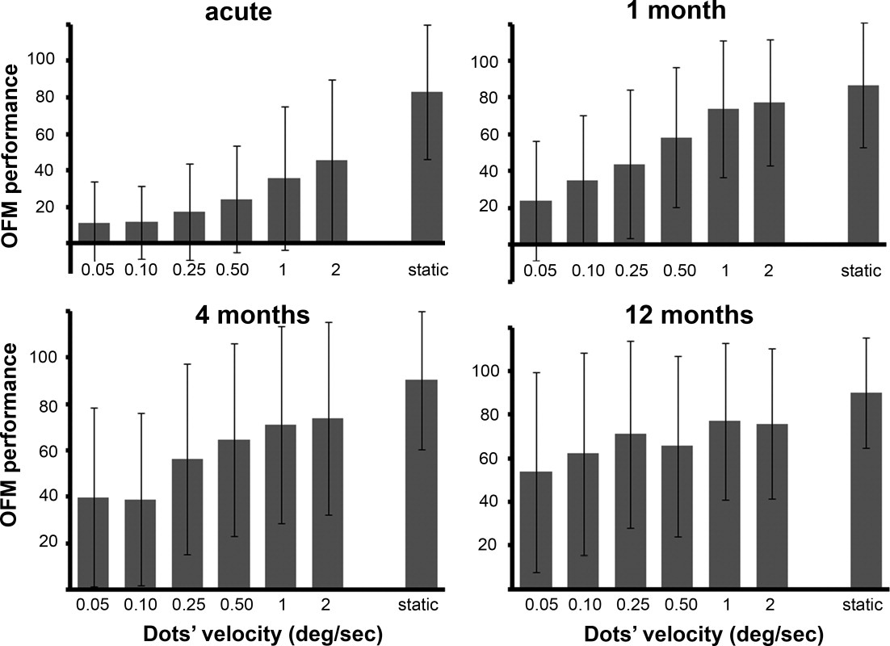
Demyelination affects temporal aspects of perception: An optic neuritis study
Annals of Neurology, Volume: 71, Issue: 4, Pages: 531-538, First published: 09 December 2011, DOI: (10.1002/ana.22692)
Notes:
Performance levels in the different object from motion (OFM) velocities. Performance level in the OFM task is plotted as a function of dots' velocity (ranging from 0.05 to 2°/s). The right column indicates performance for static, luminance‐defined objects. Performance level of the optic neuritis eyes is expressed as a percentage of normal values (ie, 100% performance level equals control subjects' mean; see Subjects and Methods).
IF THIS IMAGE HAS BEEN PROVIDED BY OR IS OWNED BY A THIRD PARTY, AS INDICATED IN THE CAPTION LINE, THEN FURTHER PERMISSION MAY BE NEEDED BEFORE ANY FURTHER USE. PLEASE CONTACT WILEY'S PERMISSIONS DEPARTMENT ON PERMISSIONS@WILEY.COM OR USE THE RIGHTSLINK SERVICE BY CLICKING ON THE 'REQUEST PERMISSIONS' LINK ACCOMPANYING THIS ARTICLE. WILEY OR AUTHOR OWNED IMAGES MAY BE USED FOR NON-COMMERCIAL PURPOSES, SUBJECT TO PROPER CITATION OF THE ARTICLE, AUTHOR, AND PUBLISHER.

